Slide 1


Lab Course Cognitive Systems: Depth & Bounding Box Prediction
Final Presentation
WS 17/18
22.03.2018
S. Aklanoglu, J. Schuck, Y. El himer, F. Retkowski

Slide 2
Motivation
DeepTLR
FCRN-SSD
FCN-DSSD
Evaluation
Future Work
3rd STAGE
ResNet50-Deconv + VGG16-SSD
1st STAGE
Goal
Background
2nd STAGE
Caffe
FZI
4th STAGE
ResNet50-Deconv-SSD-Deconv
5th STAGE
Results
Challenges
Solutions
6th STAGE
Improvements

Slide 3
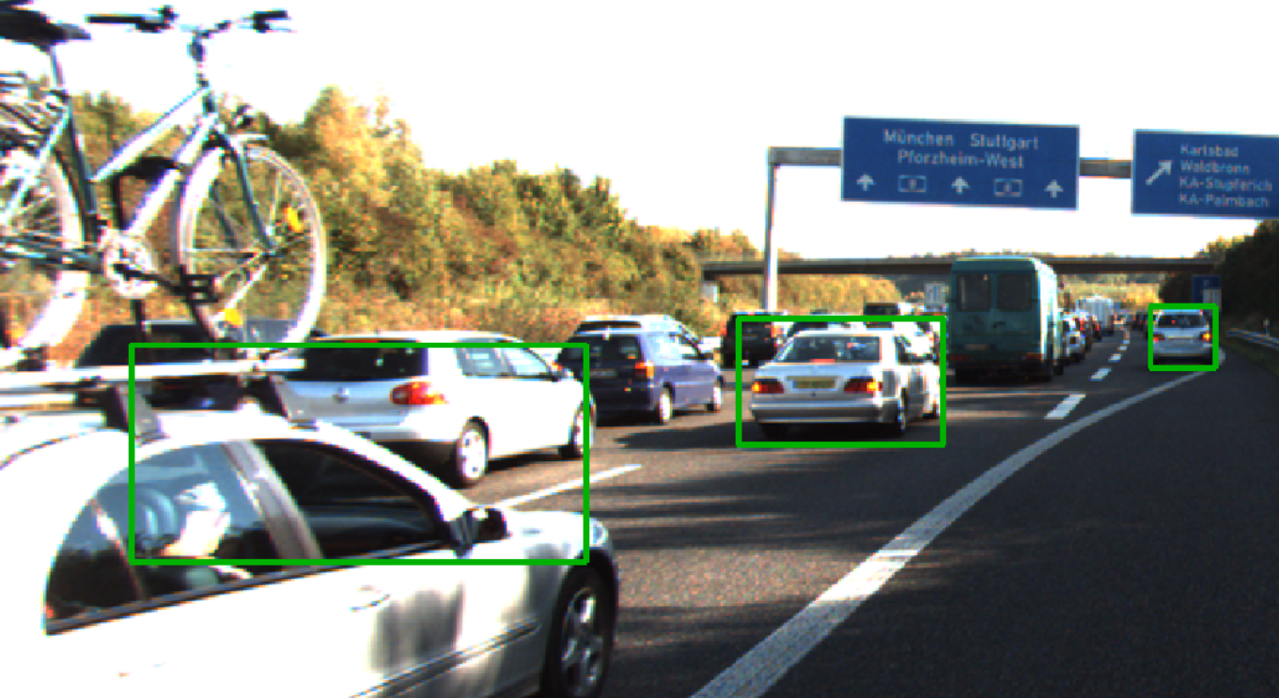
1. Motivation
Goal: Improve vehicle detections with CNN in real-time
Issues: poor performance for largely overlapping vehicles
Possible solution: using depth information to distinguish between overlapping vehicles
Evaluation of synthetic GTA V training data
22.03.2018
S. Aklanoglu, J. Schuck, Y. El himer, F. Retkowski

Slide 4
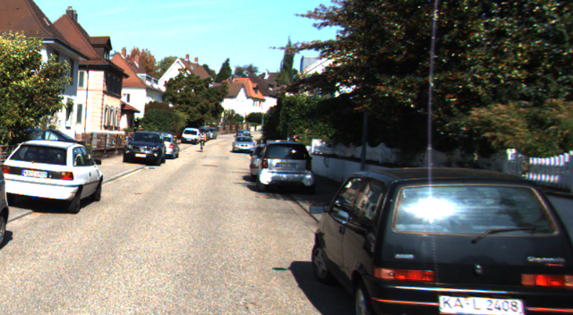
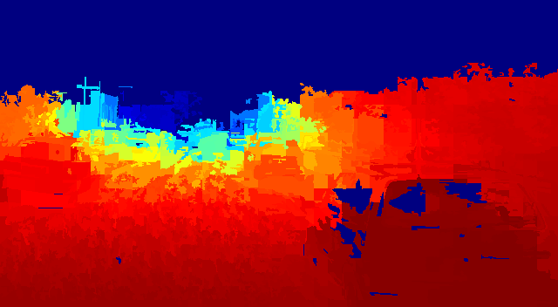
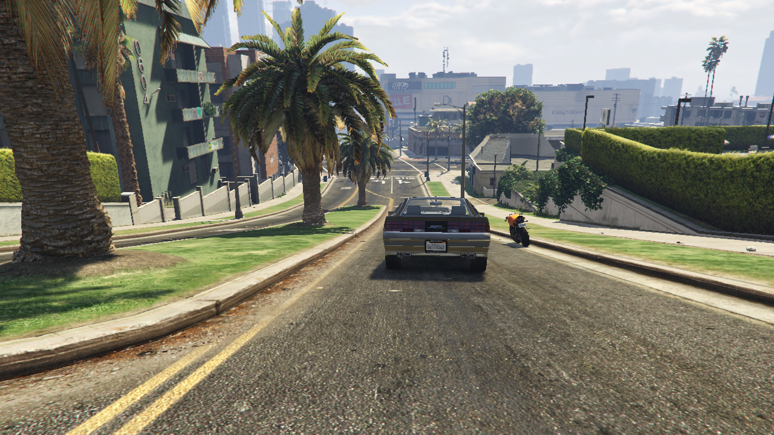
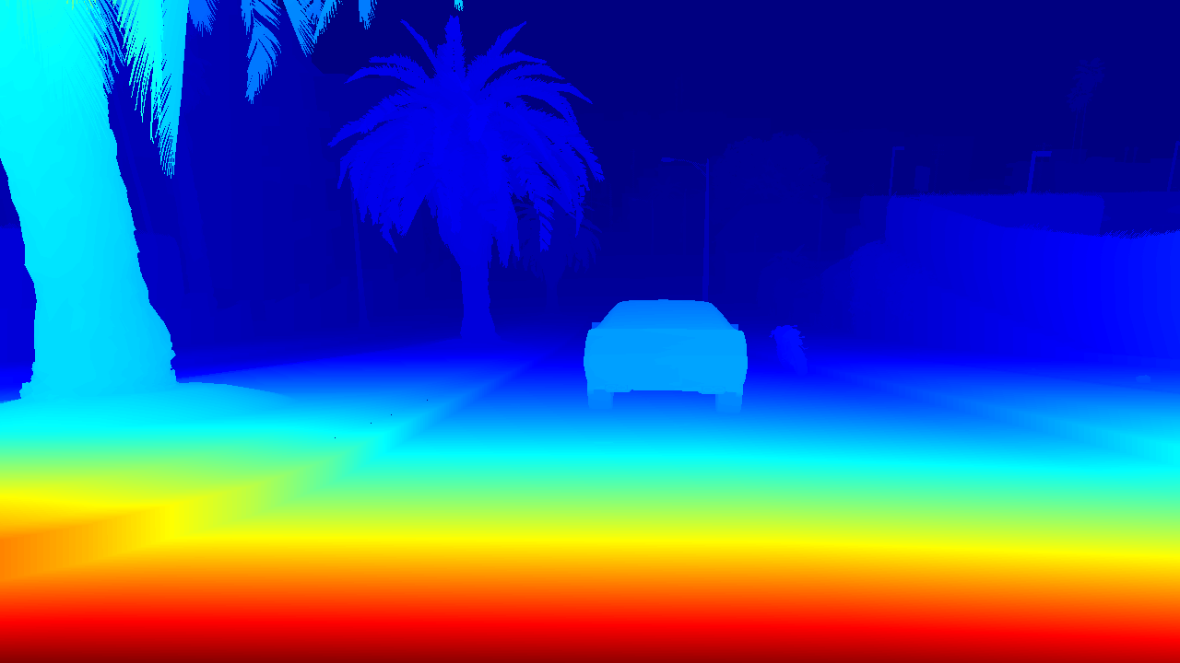
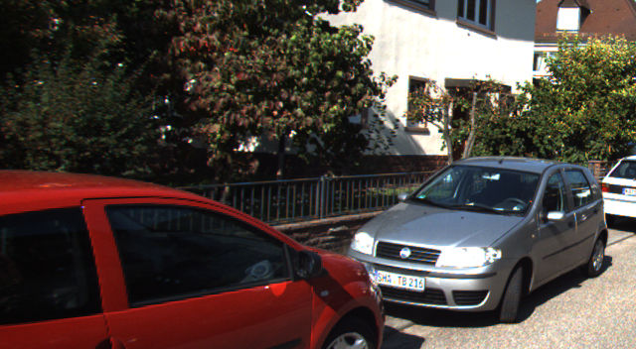
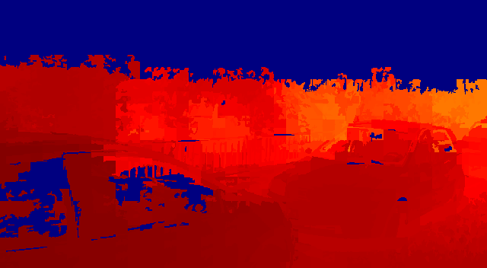
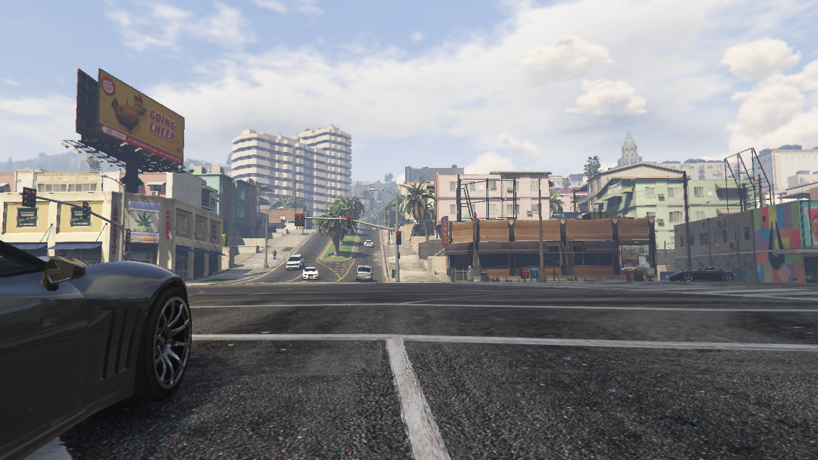
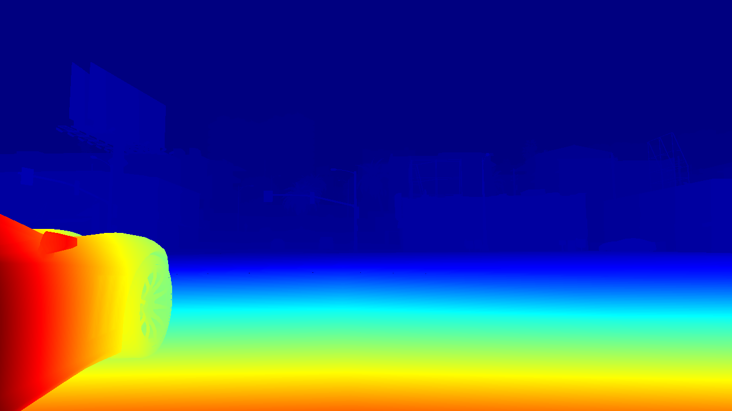
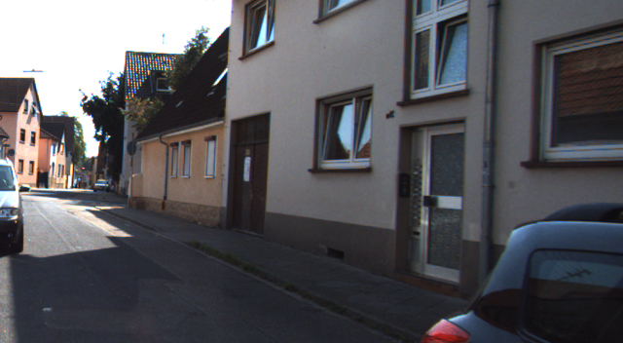
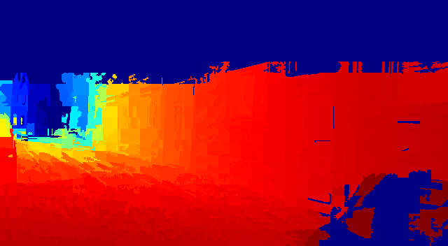
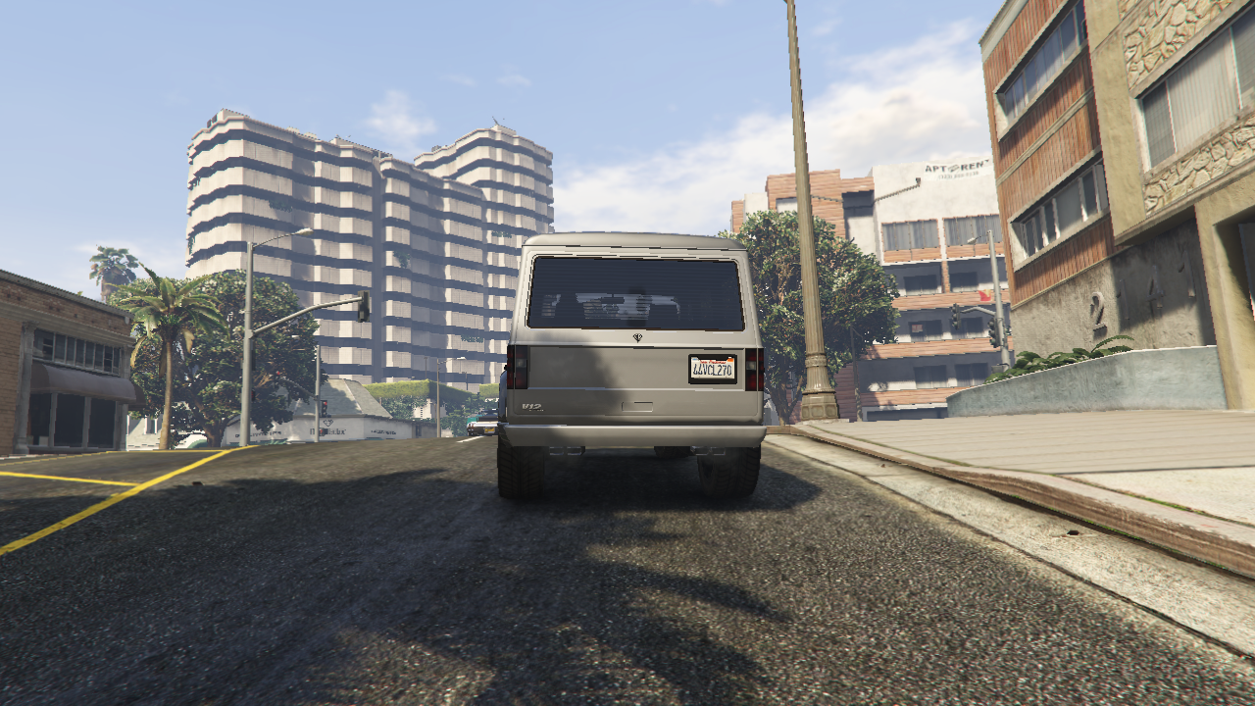
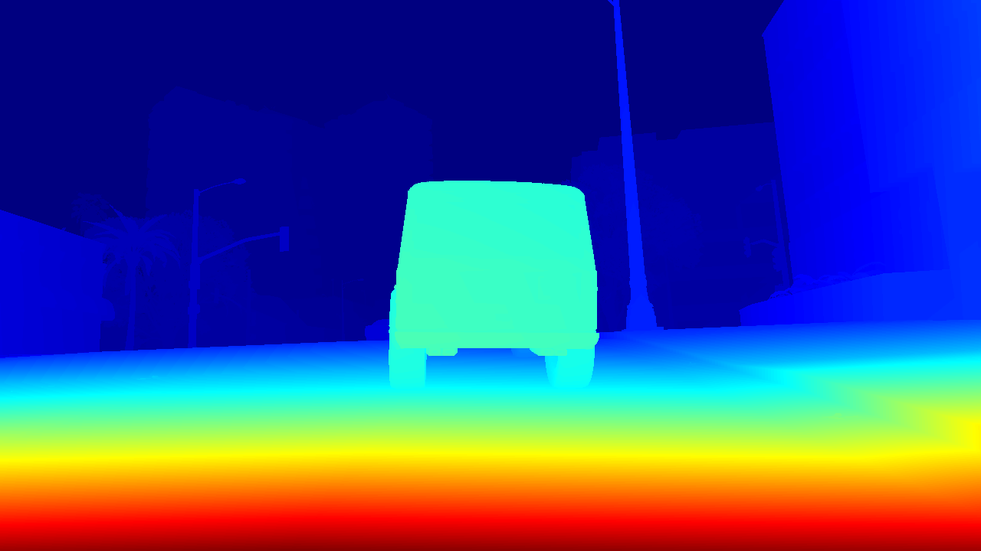
1. Motivation
Used datasets
KITTI 15k, 640 x 352, uint8 depth map
GTA V 15k, 1280 x 720, uint8 depth map
22.03.2018
S. Aklanoglu, J. Schuck, Y. El himer, F. Retkowski

Slide 5
2. DeepTLR+Conv
Learning from depth images for monocular object detection with convolutional neural networks, MA A. Lesi
Joint convolution depth prediction and object detection
Training with KITTI & GTA V images
AlexNet
Feature Extraction
Feature Classific.
Class & BB Regression
640x352x3
fc
ReLu
Dropout
Sigmoid
22.03.2018
S. Aklanoglu, J. Schuck, Y. El himer, F. Retkowski
1

Slide 6


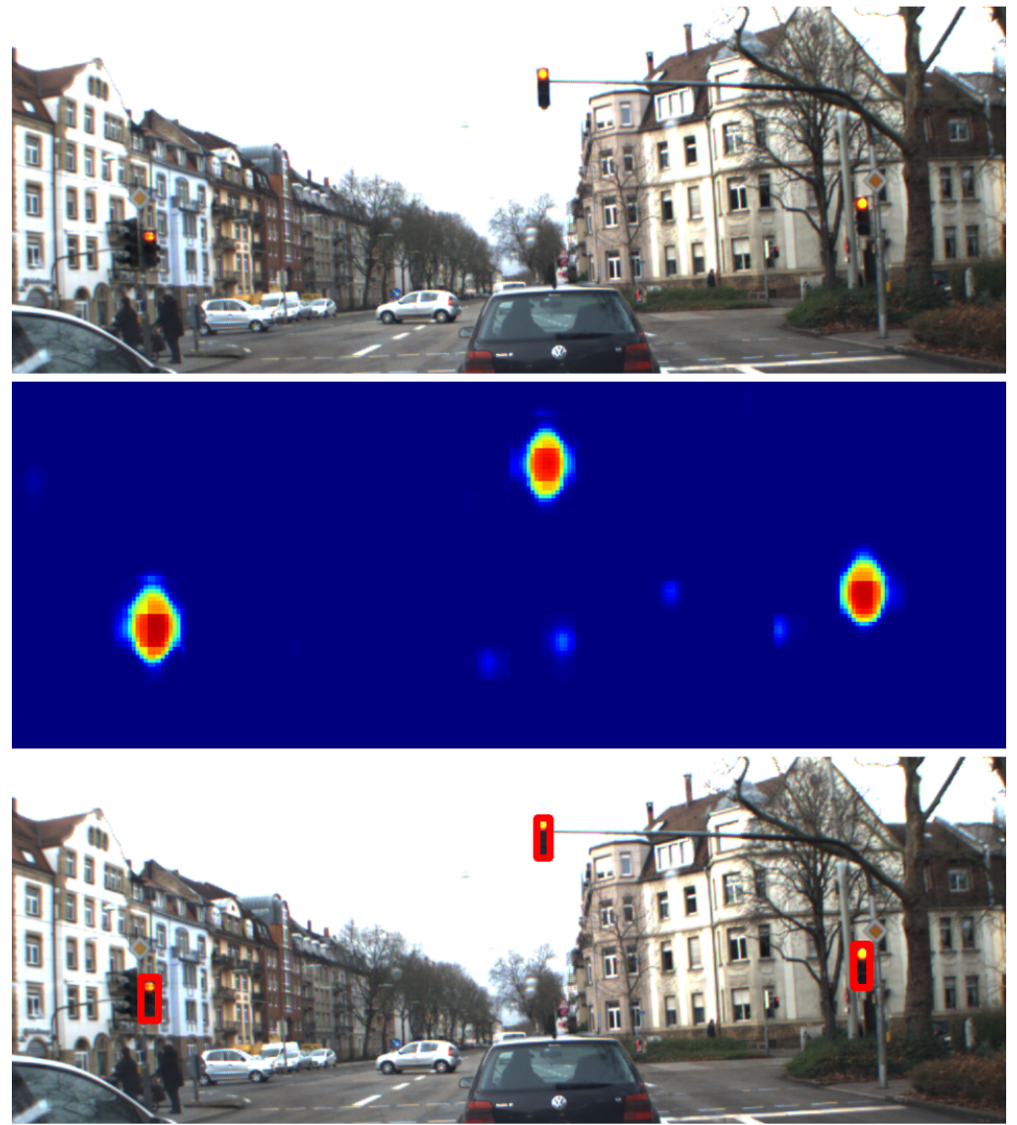
2. DeepTLR+Conv
Accomplished tasks:
Caffe running
Data processing & augmentation
LMDB creation
Training on KITTI
Training on GTAV
Training on mixed KITTI and GTAV
Evaluation routines
Using code from M. Weber and A. Lesi
No modifications on framework planned
Inference Speed: 20 – 45 ms
22.03.2018
S. Aklanoglu, J. Schuck, Y. El himer, F. Retkowski
1

Slide 7
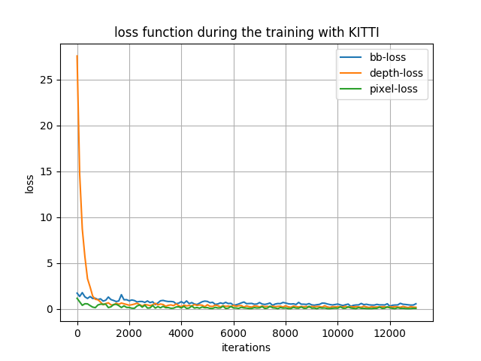
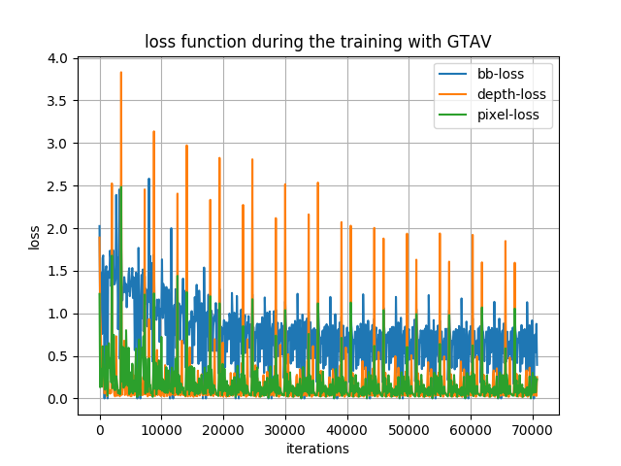
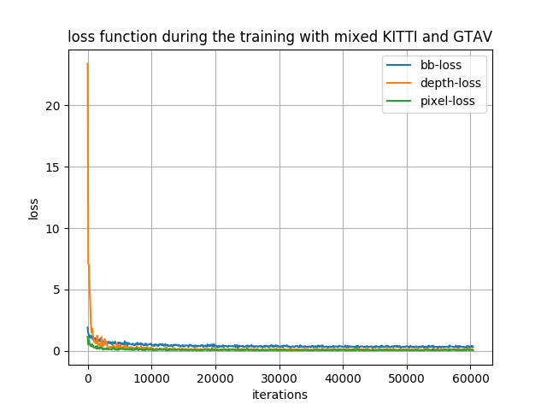
2. DeepTLR+Conv
Loss during training:
22.03.2018
S. Aklanoglu, J. Schuck, Y. El himer, F. Retkowski
1

Slide 8
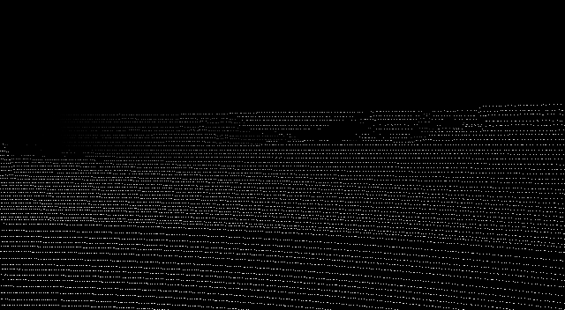
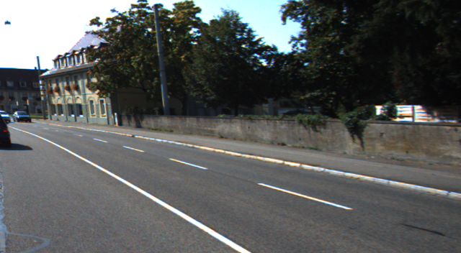
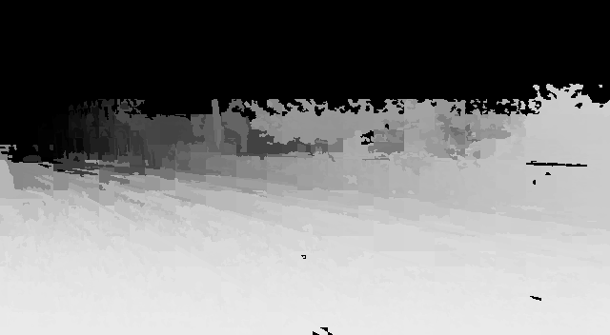
2. DeepTLR+Conv
Current results: Depth map prediction
+
22.03.2018
S. Aklanoglu, J. Schuck, Y. El himer, F. Retkowski
1

Slide 9
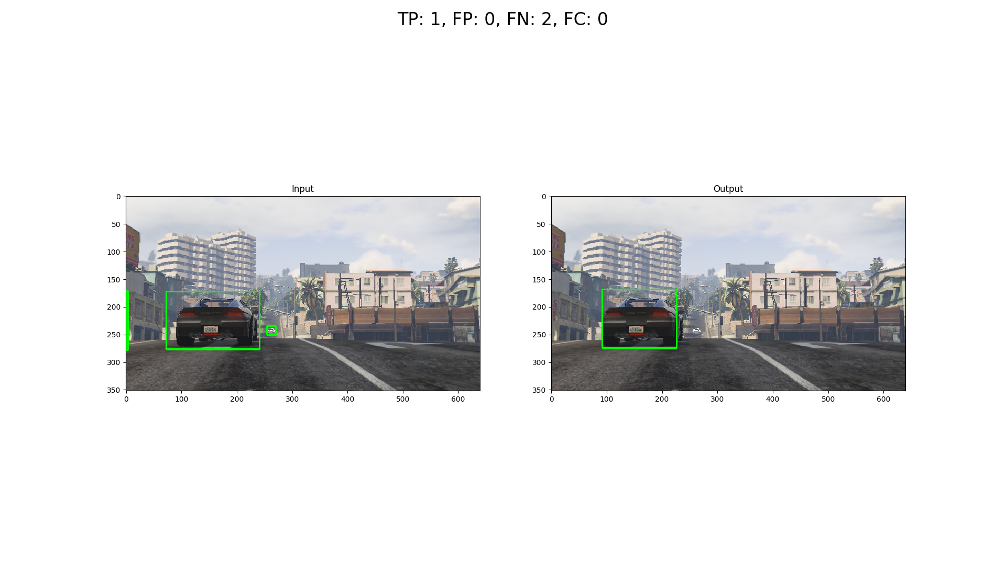
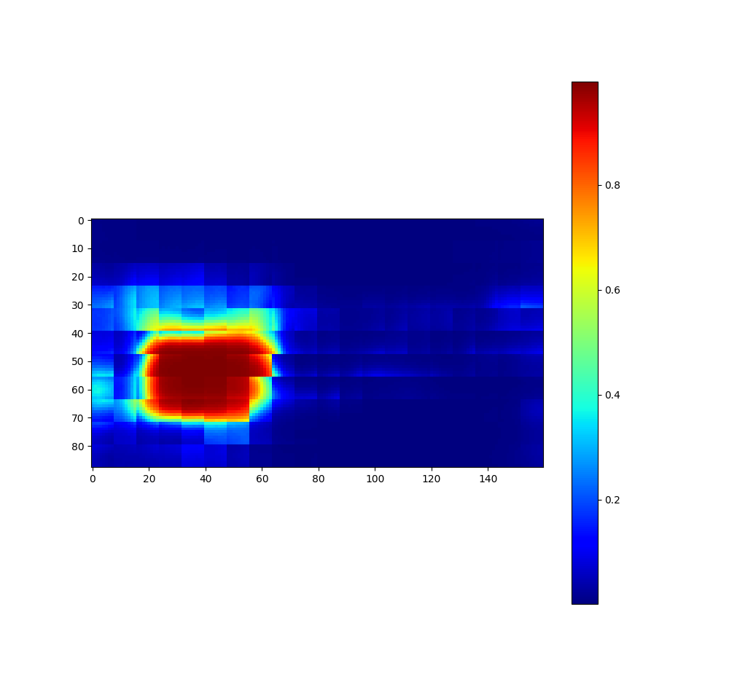
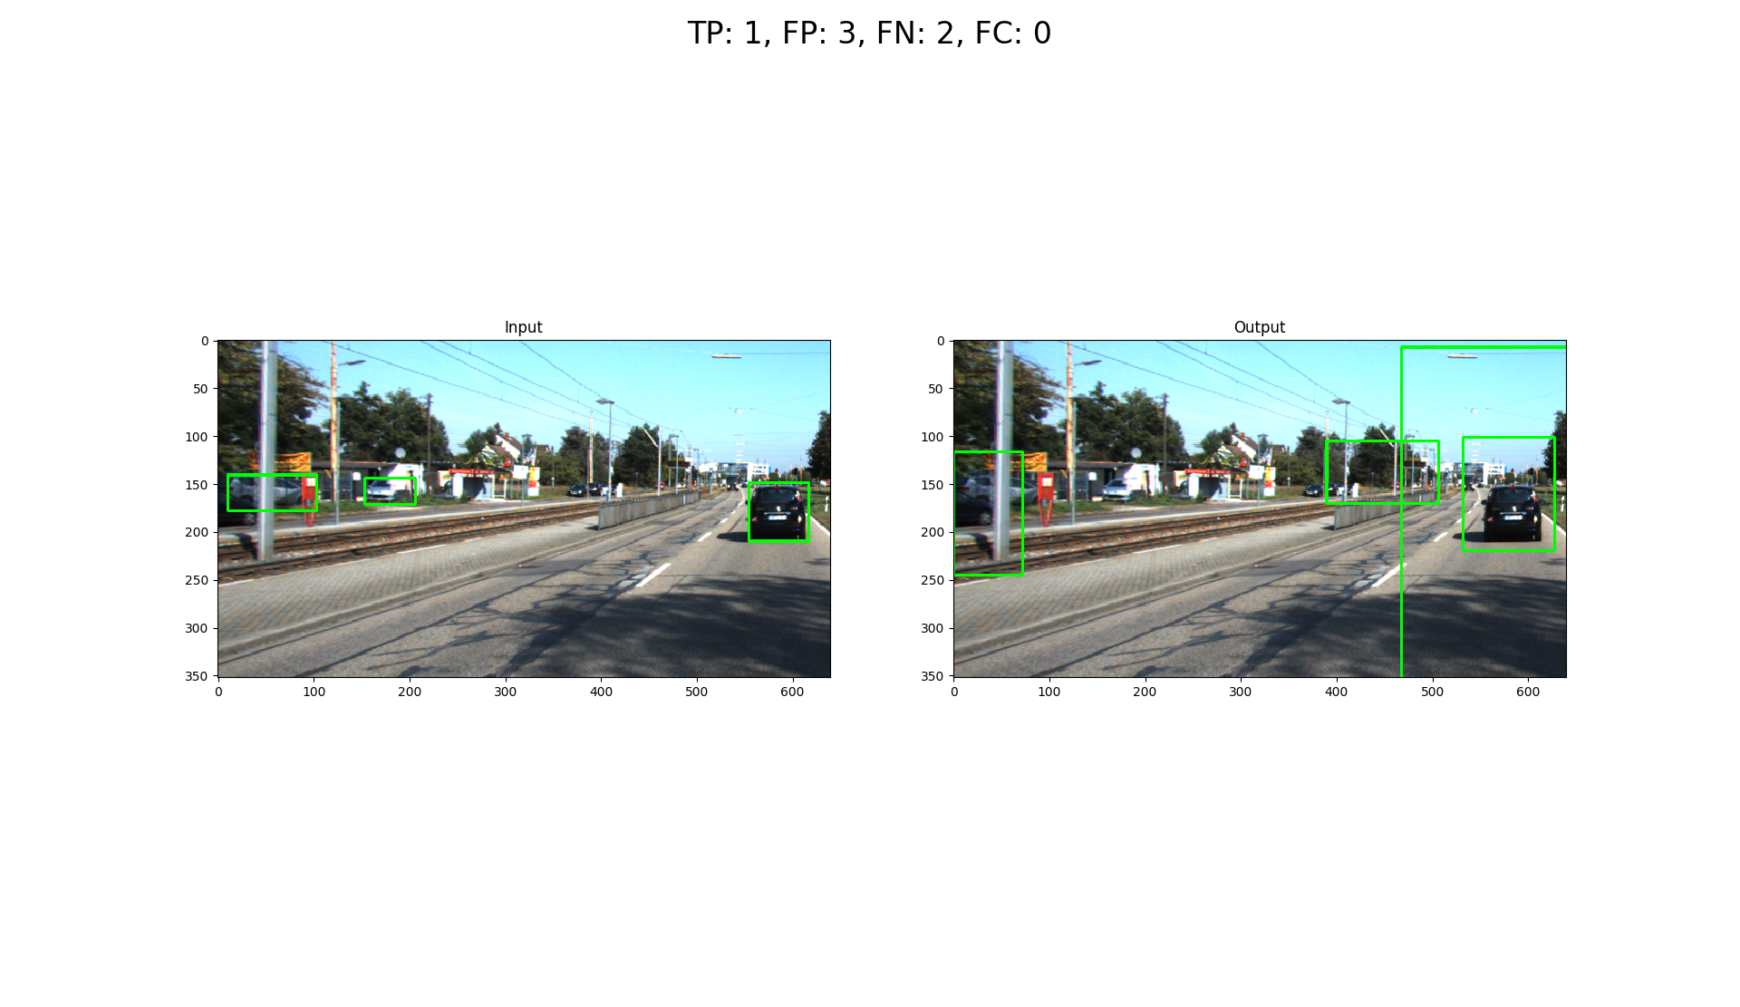
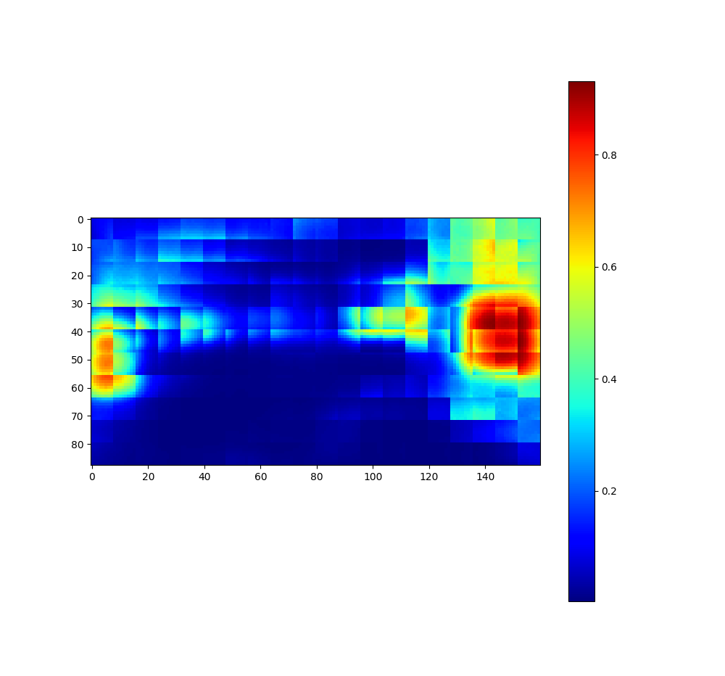
2. DeepTLR+Conv
Current results: Model trained on GTAV
Inference on GTAV instance
Inference on KITTI instance
22.03.2018
S. Aklanoglu, J. Schuck, Y. El himer, F. Retkowski
1

Slide 10
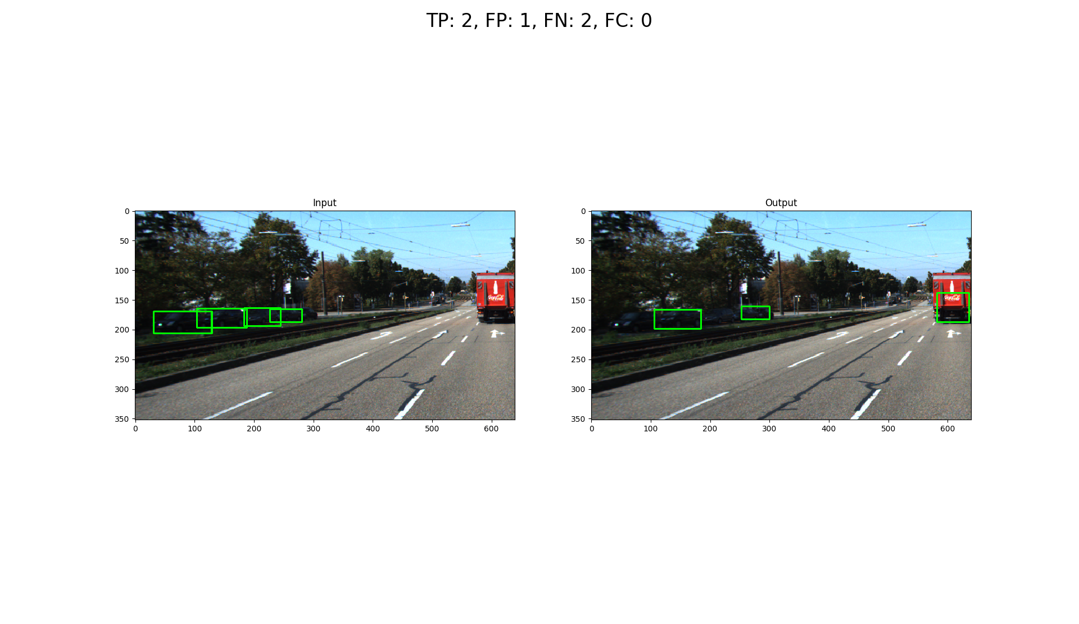
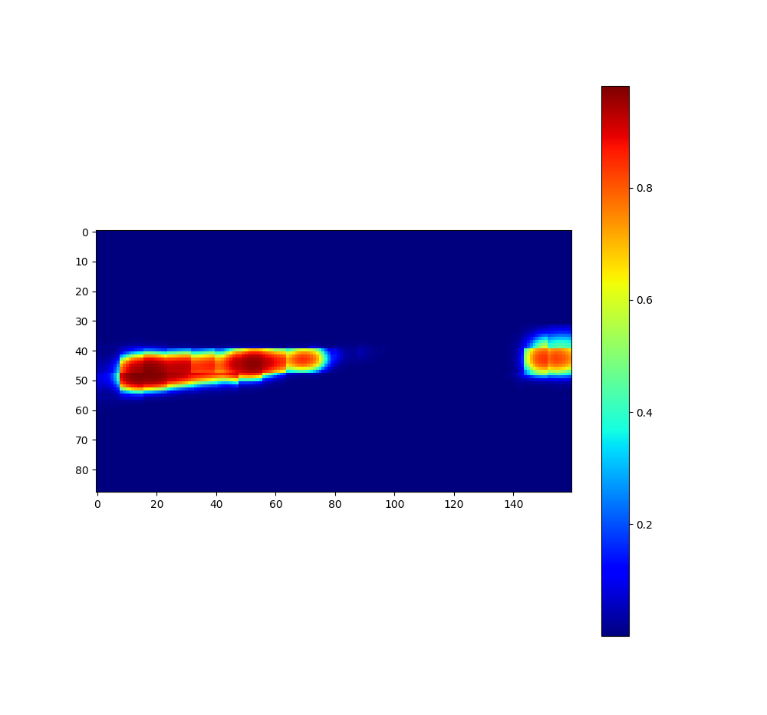
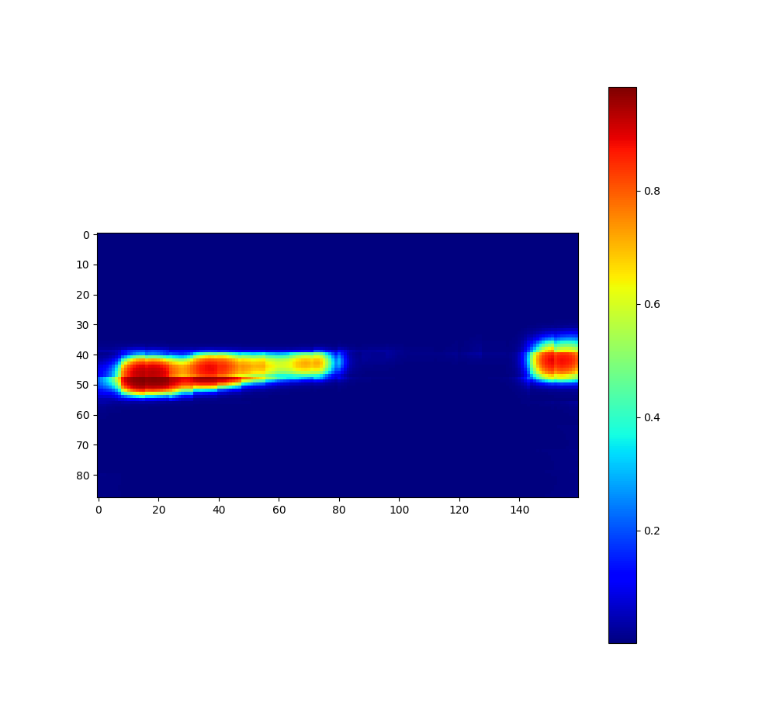

2. DeepTLR+Conv
Current results: Model trained on KITTI + GTAV
Inference on KITTI instance
Compared to the Model trained only on KITTI
22.03.2018
S. Aklanoglu, J. Schuck, Y. El himer, F. Retkowski
1

Slide 11
2. DeepTLR+Conv
Evaluation:
 | Trained on KITTI |  | Trained on GTAV
 | Evaluated on KITTI Test Data | Evaluated on GTA Test Data |  | Evaluated on KITTI Test Data
REL
LOG10
RMS
S. Aklanoglu, J. Schuck, Y. El himer, F. Retkowski
22.03.2018
1

Slide 12
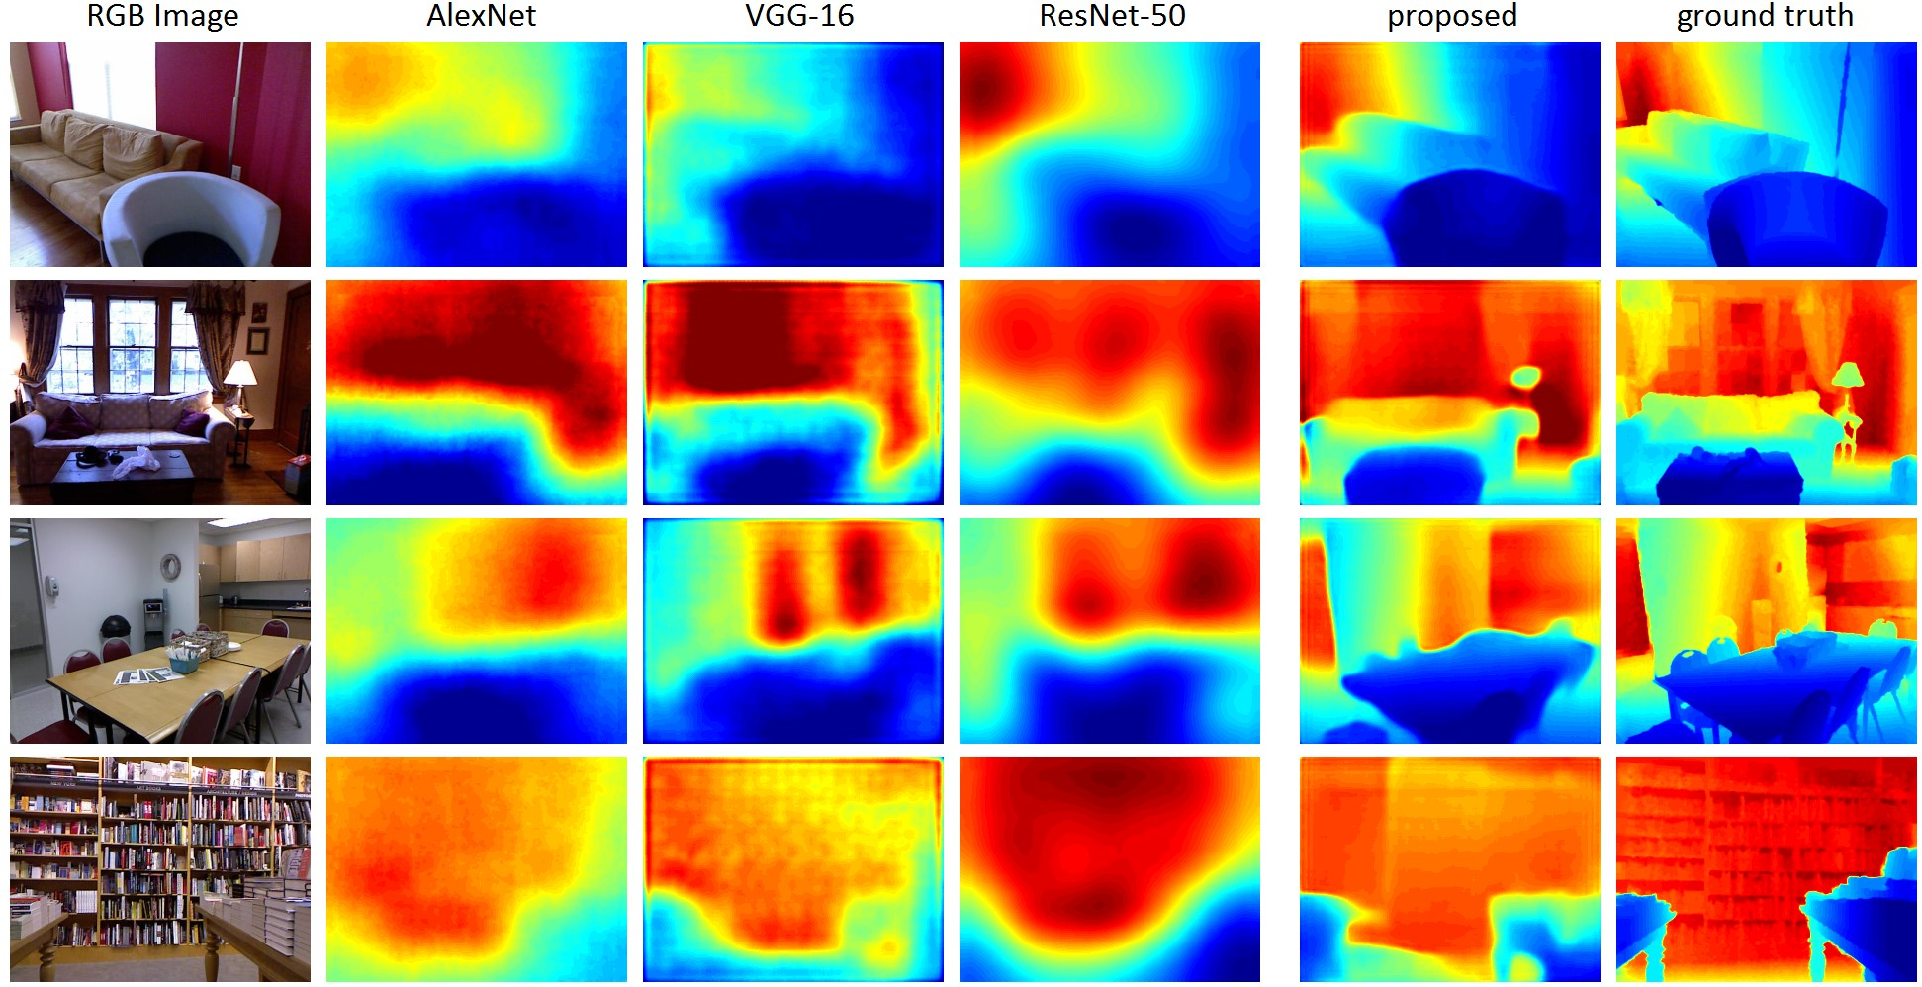
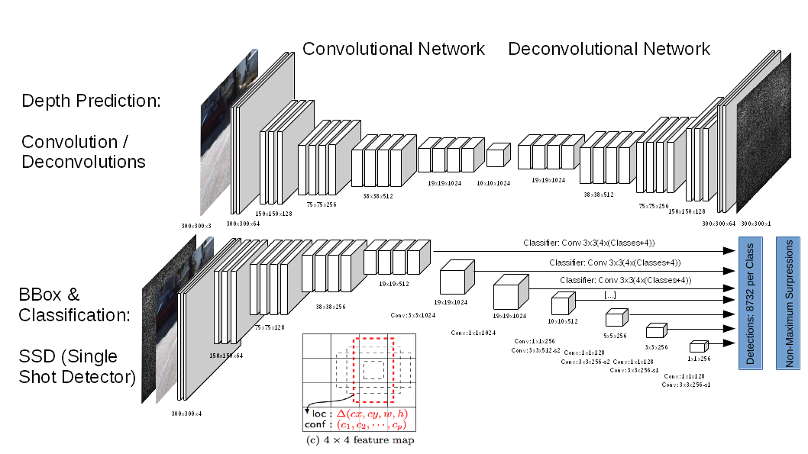
3. FCRN-SSD
Deeper Depth Prediction with Fully Convolutional Residual Networks, Laina et al.
+ SSD: Single Shot MultiBox Detector, Liu et al.
22.03.2018
S. Aklanoglu, J. Schuck, Y. El himer, F. Retkowski
1
300x300x3
300x300x3

Slide 13
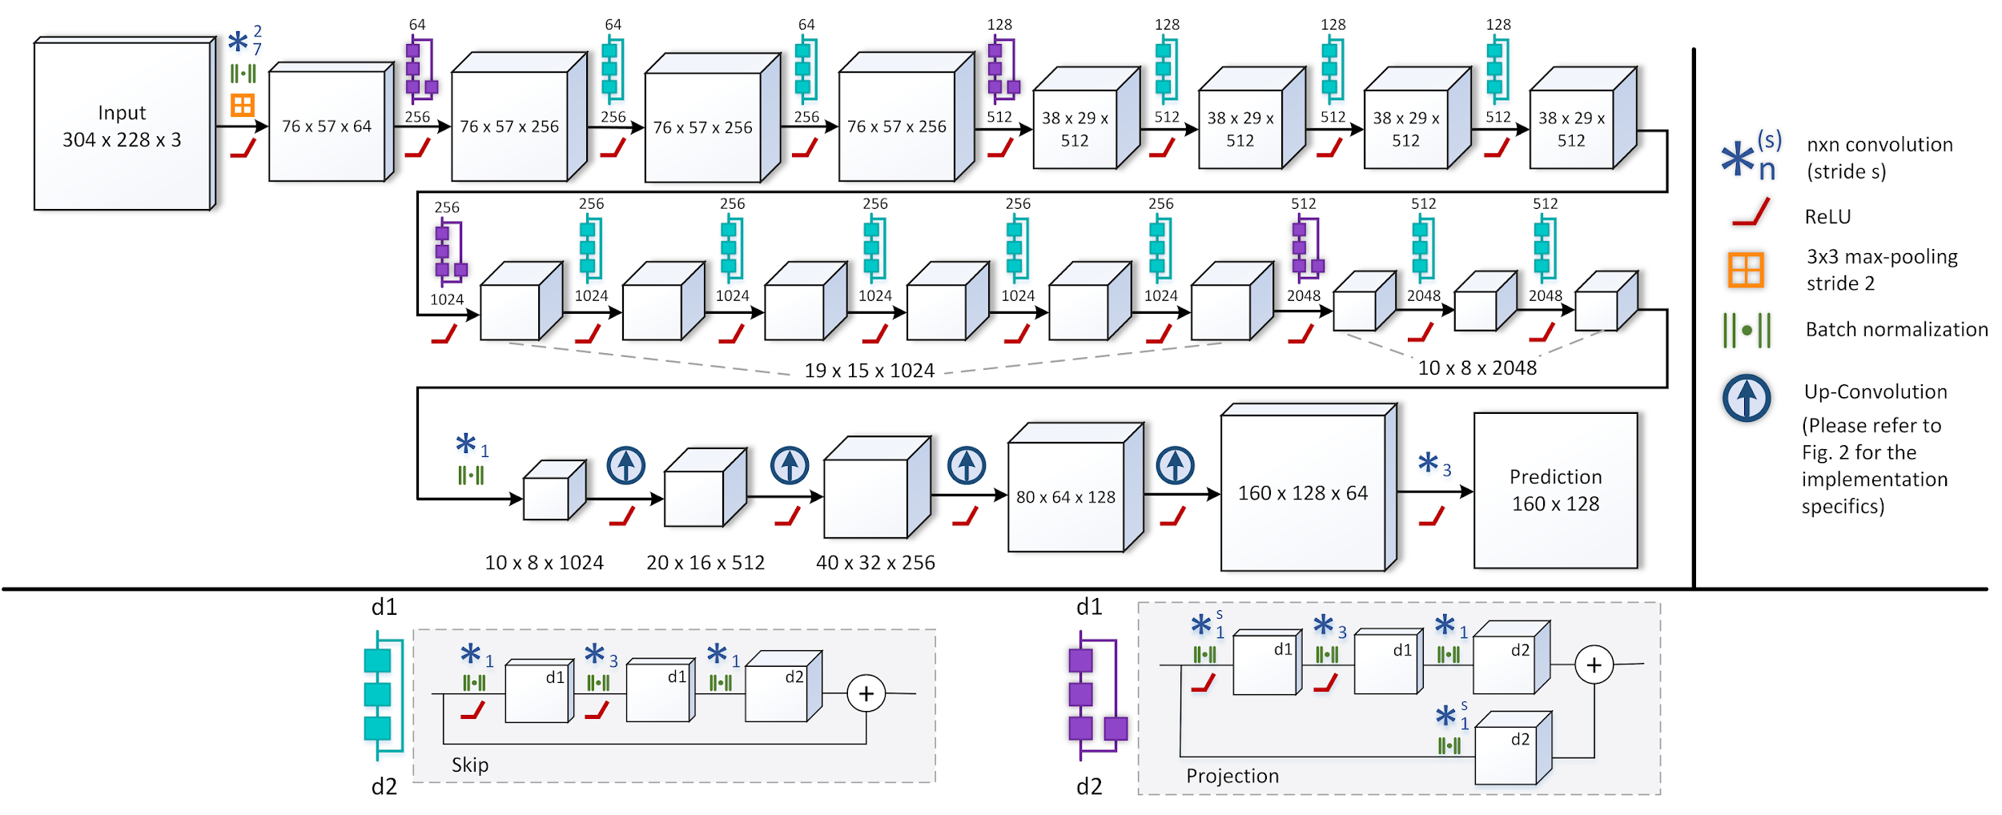
3. FCRN-SSD
Deeper Depth Prediction with Fully Convolutional Residual Networks, Laina et al.
+ SSD: Single Shot MultiBox Detector, Liu et al.
22.03.2018
S. Aklanoglu, J. Schuck, Y. El himer, F. Retkowski
1

Slide 14


3. FCRN-SSD
What was available with FCRN?
Architecture in TensorFlow
Evaluation Routines in Matlab
300 px
What have we done with FCRN?
Architecture customized
Data Processing
Trainings Routines
Training on KITTI data
Training on GTA data
Evaluation Routines
300 px
22.03.2018
S. Aklanoglu, J. Schuck, Y. El himer, F. Retkowski
1

Slide 15
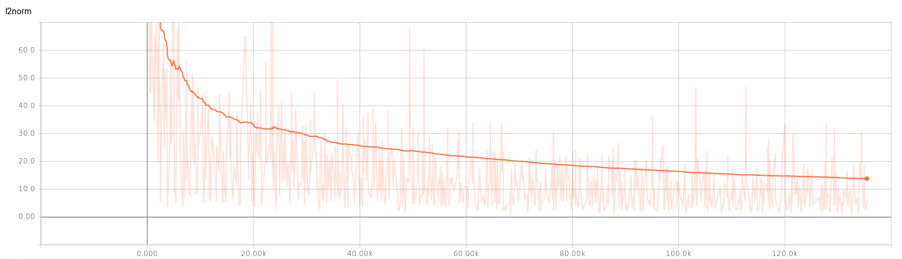
3. FCRN-SSD
22.03.2018
S. Aklanoglu, J. Schuck, Y. El himer, F. Retkowski
1

Slide 16
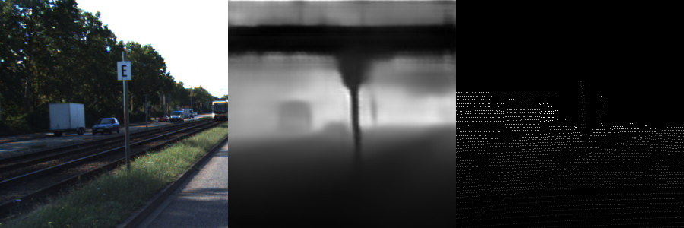
3. FCRN-SSD
22.03.2018
S. Aklanoglu, J. Schuck, Y. El himer, F. Retkowski
1

Slide 17
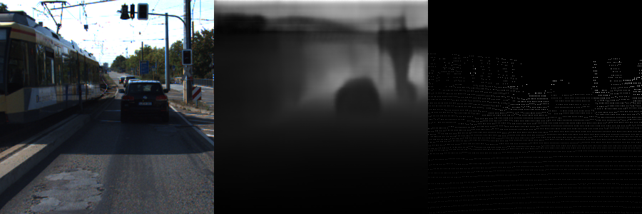
3. FCRN-SSD
22.03.2018
S. Aklanoglu, J. Schuck, Y. El himer, F. Retkowski
1

Slide 18
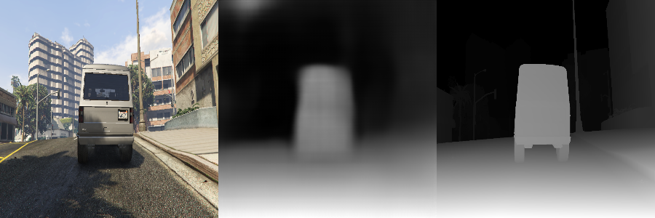
3. FCRN-SSD
22.03.2018
S. Aklanoglu, J. Schuck, Y. El himer, F. Retkowski
1

Slide 19
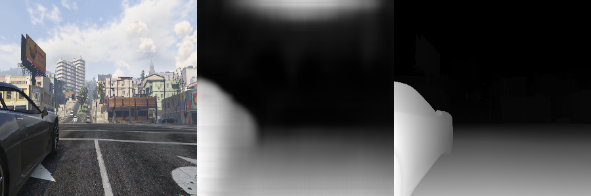
3. FCRN-SSD
22.03.2018
S. Aklanoglu, J. Schuck, Y. El himer, F. Retkowski
1

Slide 20
3. FCRN-SSD
Evaluation:
 | Trained on KITTI |  | Trained on GTA
 | Evaluated on KITTI Test Data | Evaluated on GTA Test Data |  | Evaluated on KITTI Test Data
MAPE
MSE
RMSE
S. Aklanoglu, J. Schuck, Y. El himer, F. Retkowski
22.03.2018
1

Slide 21
3. FCRN-SSD
We chose the FCRN approach because of superior depth prediction performance
Deconvolutional Network originally used for semantic segmentation did not train (with RMSE or Huber loss) and remained noisy
Next step: Combining with Bounding Box Prediction
Advantages of two isolated neural nets:
Stable depth prediction
Stable bounding box detection
In multitask Learning often hard to get loss function right
Easier/better evaluation of GTAV training data with two distinct networks

Slide 22
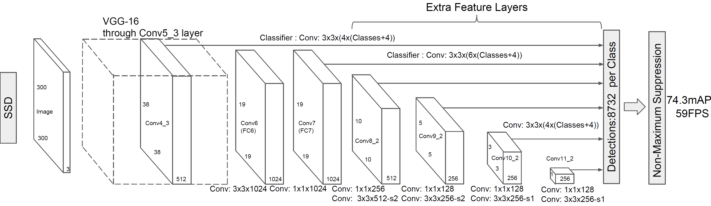
3. FCRN-SSD
Deeper Depth Prediction with Fully Convolutional Residual Networks, Laina et al.
+ SSD: Single Shot MultiBox Detector, Liu et al.

Slide 23
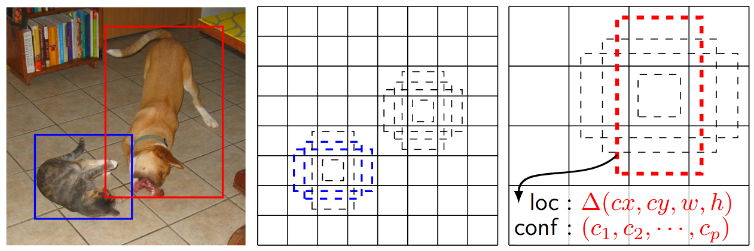
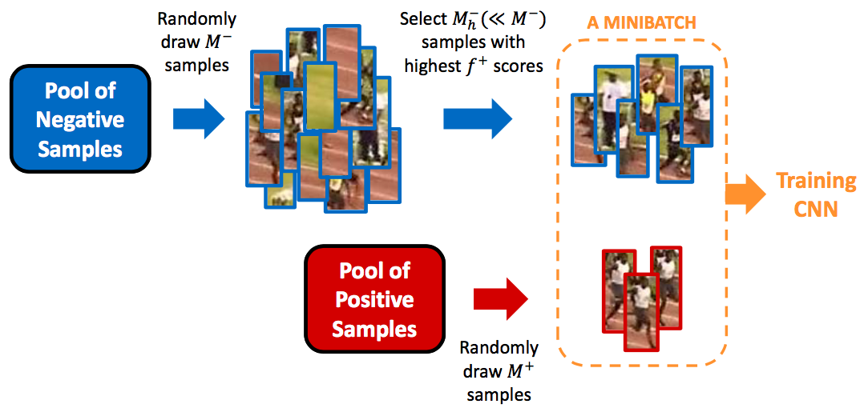
3. FCRN-SSD
Multibox approach
Uses predefined deafult boxes with different sizes and ratios (adjustment according dataset)
For every default box IOU will be calculated with groundtruth boxes
Boxes will be estimated on multiple feature layers with different feature map sizes and 6 boxes per cell
Most of unused default boxes will be deleted and non-maximum suppression is used to obtain final boxes
Hard negative mining with ratio of negative to positive examples of around 3:1
22.03.2018
S. Aklanoglu, J. Schuck, Y. El himer, F. Retkowski
1

Slide 24
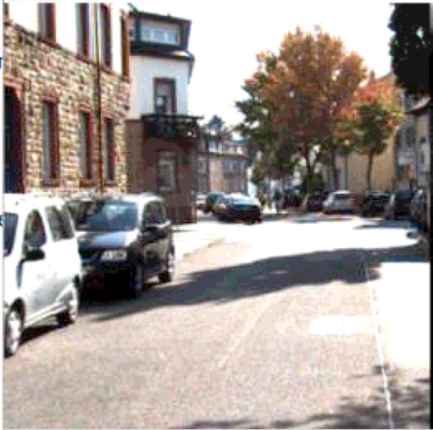
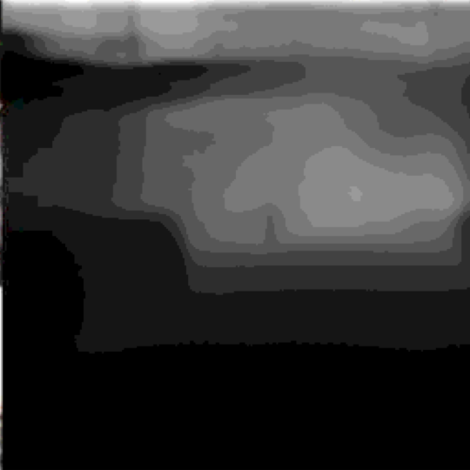
3. FCRN-SSD
Evaluation:
 | Without Depth Channel | With Depth Channel (GATV) | With Depth Channel (KITTI)
mAP
IoU
?
Kitti Object
FCRN pred.
Parameters:
Class threshold: 0.8, num_classes=8, nms (non maximum selection), treshold: 0.3
SSD

Slide 25
4. FCN-DSSD
Deeper Depth Prediction with Fully Convolutional Residual Networks, Laina et al.
+ SSD: Single Shot MultiBox Detector, Liu et al.
+ DSSD : Deconvolutional Single Shot Detector Fu et al.
End-to-end depth and bounding box prediction:
Deconvolution / Upprojection
384 x 384 x 1
PM
384 x 384 x 3
PM
PM
Deconvolution
FCN
ResNet50
PM
48 x 48 x 512
12 x 12 x 2048
PM
3 x 3 x 256
1 x 1 x 128
PM
SSD
DM
6 x 6 x 512
12 x 12 x 1024
24 x 24 x 1024
48 x 48 x 512
22.03.2018
S. Aklanoglu, J. Schuck, Y. El himer, F. Retkowski
1

Slide 26
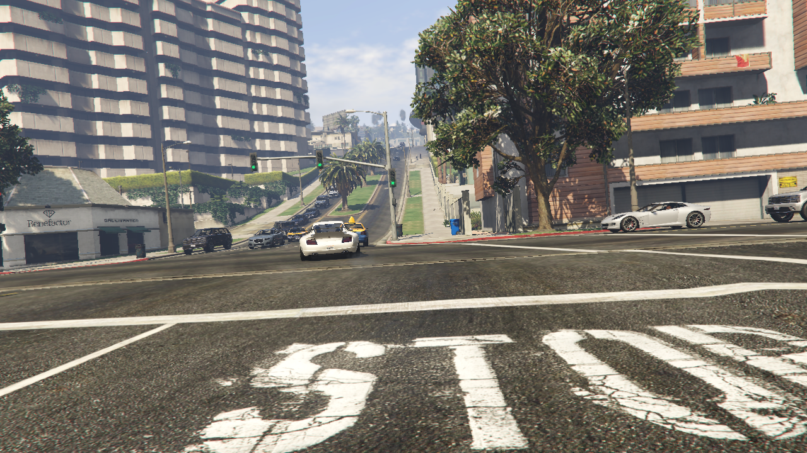
4. FCN-DSSD
Image Preprocessing:
Online image augmentation in Tensorflow
Random horizontal flip
Random color distortion
Patch sampling
22.03.2018
S. Aklanoglu, J. Schuck, Y. El himer, F. Retkowski
1

Slide 27
4. FCN-DSSD
Draft
Evaluation:
Speed: training is slow ~ 5 days, inference 900 ms per batch → 56,25 ms – 17 Hz
Mean average precision for SSD:
KITTI: ~25% mAP after 30k iters
GTAV: very low mAP, not learning at all ~1-8% after 200k iters
Depth prediction:
KITTI: depth not learning, only after 40k iters
GTAV: depth learning good
22.03.2018
S. Aklanoglu, J. Schuck, Y. El himer, F. Retkowski
1

Slide 28
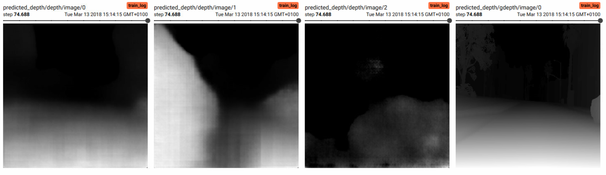
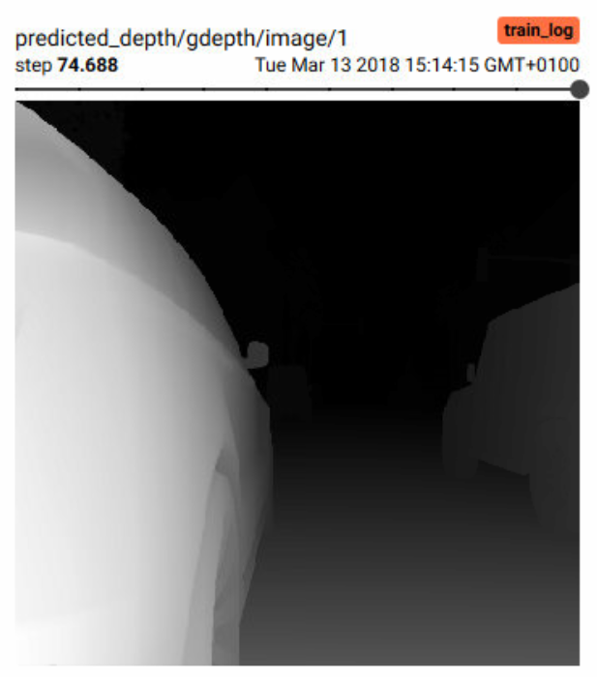
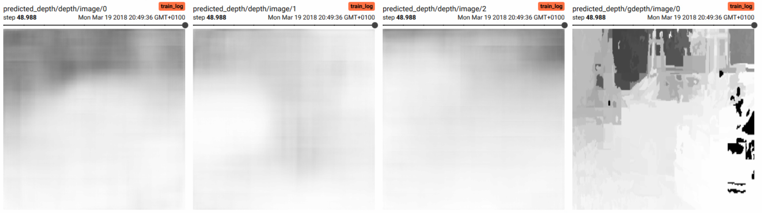
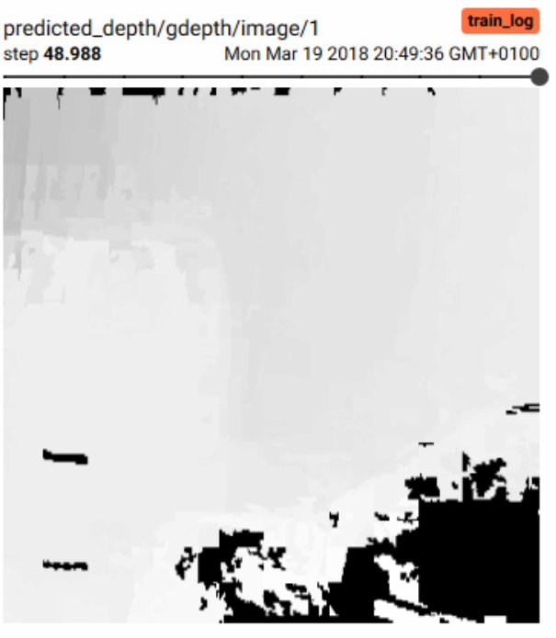
4. FCN-DSSD
Draft
KITTI
GTAV
Groundtruth
Predicted
22.03.2018
S. Aklanoglu, J. Schuck, Y. El himer, F. Retkowski
1

Slide 29
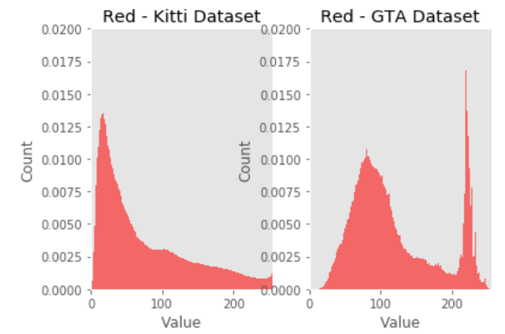
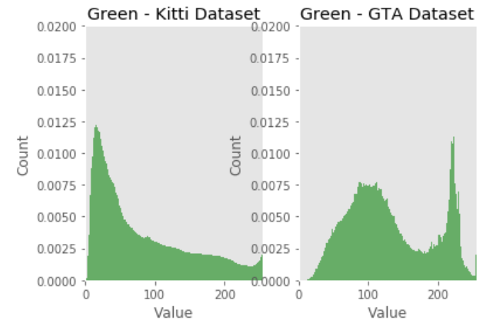
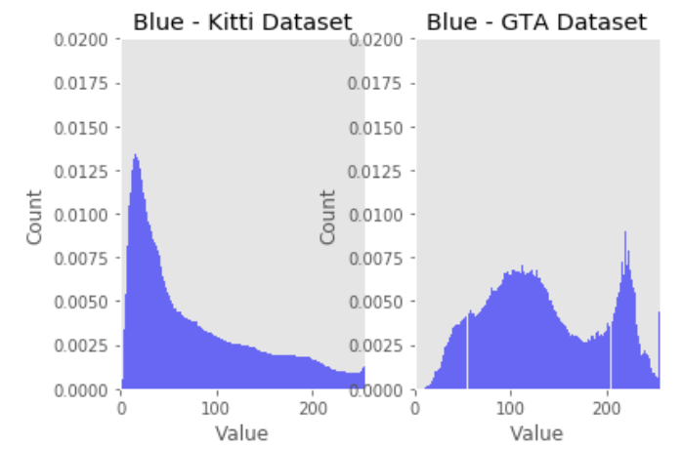
5. Evaluation
22.03.2018
S. Aklanoglu, J. Schuck, Y. El himer, F. Retkowski
1

Slide 30
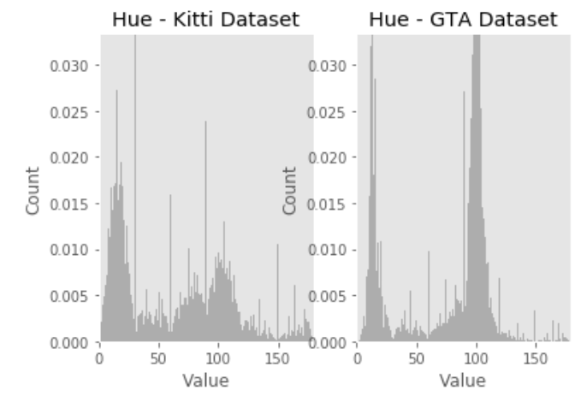
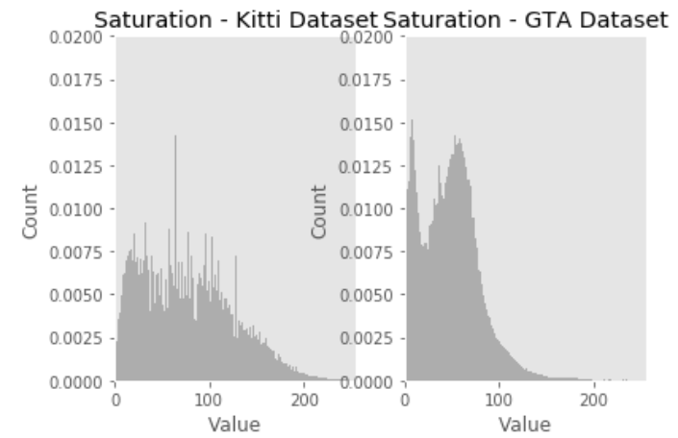

5. Evaluation
22.03.2018
S. Aklanoglu, J. Schuck, Y. El himer, F. Retkowski
1

Slide 31


5. Evaluation
KITTI
GTAV
22.03.2018
S. Aklanoglu, J. Schuck, Y. El himer, F. Retkowski
1

Slide 32


5. Evaluation
KITTI
GTAV
22.03.2018
S. Aklanoglu, J. Schuck, Y. El himer, F. Retkowski
1

Slide 33

5. Evaluation
Summary:
Depth prediction trained on GTAV data works good, due to “perfect” data with all 3 approaches
Bounding box prediction with GTAV data is difficult and needs careful parameter choosing/tuning for all approaches
Using loss weights with 4:1 or 8:1 (SSD:FCN) when multitask training on GTA V or 1:4 when training on KITTI
GTAV trained networks works WELL/BAD on KITTI datasets …
22.03.2018
S. Aklanoglu, J. Schuck, Y. El himer, F. Retkowski
1

Slide 34
6. Future Work
Datasets:
Do offline preprocessing to handle ground truth bounding boxes out of range
Need to use more GTA V images ~ 200.000 images, since difference in images is very low
Adjust color ranges of GTA V data according KITTI
Eliminate wrong bounding boxes due to insufficient occlusion handling in game – using stencil map for bounding box creation and matching with data needed
SSD:
loss has problems to converge, especially for positive bounding box examples and localization; lots of small bounding boxes in GTA V data, better default box sizes, ratios and tiling needed
22.03.2018
S. Aklanoglu, J. Schuck, Y. El himer, F. Retkowski
1

Slide 35
6. Future Work
FCN-DSSD:
Networks are in modular architecture, it’s easy to change certain parts/networks – trying other detectors
Extend code to support multiple GPUs for faster training, since a lot of trial and error is needed to get optimal loss weights, default box sizes, ratios, tiling etc.
If learning rate too high, SSD loss will oscillate, depth loss will converge fast
If learning rate too low, depth loss will not converge, SSD loss will oscillate less
Finding optimal weight for both loss function - Adaptive Loss Balancing
22.03.2018
S. Aklanoglu, J. Schuck, Y. El himer, F. Retkowski
1

Slide 36



Questions?

Slide 37
Backup

Slide 38


3. FCRN-SSD
Deeper Depth Prediction with Fully Convolutional Residual Networks, Laina et al.
+ SSD: Single Shot MultiBox Detector, Liu et al.
22.03.2018
S. Aklanoglu, J. Schuck, Y. El himer, F. Retkowski
1
Up-projection: adds a 3x3 convolution after the Unpooling and a projection (=res-blocks) connection from the lower resolution feature map to the result
high-level info efficiently passed forward
increase feature map sizes
Deconvolution: Reverse operation of convolution
single input activation with multiple outputs
enlarged and dense activation map
Pooling: filter noisy activations in lower layers with single value representation
spatial information lost, critical for localization
Unpooling: Reverse operation of pooling
increases the spatial resolution of feature maps

Slide 39
4. FCN-DSSD
Deeper Depth Prediction with Fully Convolutional Residual Networks, Laina et al.
+ SSD: Single Shot MultiBox Detector, Liu et al.
+ DSSD : Deconvolutional Single Shot Detector Fu et al.
SSD Deconvolution Module
Deconv layer H x W x 512
2H x 2W x 512
Deconv 2x2x512
Conv 3x3x512
BN
Eltw. Product
ReLU
Conv 3x3x512
BN
ReLU
Conv 3x3x512
BN
Feature layer (SSD)
2H x 2W x D
22.03.2018
S. Aklanoglu, J. Schuck, Y. El himer, F. Retkowski
1

Slide 40
4. FCN-DSSD
Deeper Depth Prediction with Fully Convolutional Residual Networks, Laina et al.
+ SSD: Single Shot MultiBox Detector, Liu et al.
+ DSSD : Deconvolutional Single Shot Detector Fu et al.
SSD Prediction Module
Cls
Eltw. Sum
Loc Regress
Conv 1x1x1024
Conv 1x1x1024
Conv 1x1x256
Conv 1x1x256
Feature Layer
22.03.2018
S. Aklanoglu, J. Schuck, Y. El himer, F. Retkowski
1

Slide 41




4. FCN-DSSD
Deeper Depth Prediction with Fully Convolutional Residual Networks, Laina et al.
+ SSD: Single Shot MultiBox Detector, Liu et al.
+ DSSD : Deconvolutional Single Shot Detector Fu et al.
Loss functions:
Depth: berHu
SSD:
$$Β(x)= \left\{\begin{aligned}\left|x\right|, \left|x\right| ≤c \\ \frac{x^{2}+c^{2}}{2c},\left|x\right| >c\end{aligned}\right.$$
$c=\frac{1}{5}\max_{i}{(\left|\tilde{y_{i}}−y_{i}\right|)}$,
$$L\left(x,c,p,g\right)=\frac{1}{N}\left(L_{conf}\left(x,c\right)+ αL_{loc}\left(x,p,g\right)\right), α=1, N=\# matched default bb$$
$$L_{loc}\left(x,p,g\right)=\sum_{i∈Pos}^{N}{\sum_{m∈\{cx,cy,w,h\}}{x_{ij}^{k}smooth_{L1}(p_{i}^{m} −{\hat{g_{j}}}^{m})}}$$
$$L_{conf}\left(x,c\right)=−\sum_{i∈Pos}^{N}{x_{ij}^{p}log⁡({\hat{c_{i}}}^{p})}−\sum_{i∈Neg}{log⁡({\hat{c_{i}}}^{0})}$$
22.03.2018
S. Aklanoglu, J. Schuck, Y. El himer, F. Retkowski
1

